Slide 1
IT Infrastructure

Slide 2
Agenda – Day 1
Introduction to Networking Devices
Overview of LAN and WAN technologies
IPv4 and IPv6
Datacenter Overview
Server form factor
Server Management portal (IPMI/iLO, iDrac)
Server Events
Basics of storage (NAS, DAS and SAN)
Comparing Fibre Channel, iSCSI, and Fibre Channel over Ethernet

Slide 3
Agenda – Day 2
Concept of RAID
Introduction to Operating systems (Server and Client)
Concept of Domain and Workgroup
File Systems (FAT, NTFS, ReFS, EXT3, EXT4 etc)
File system management
Installing Operating system (Windows 10, Server 2016, Linux
Installing OS using management Console
Firewall (Hardware and Software)

Slide 4
What is a Computer Network?
A computer network is a system that connects many independent computers to share information (data) and resources.
The integration of computers and other different devices allows users to communicate more easily.
A network connection can be established using either cable or wireless media.
Hardware and software are used to connect computers and tools in any network.

Slide 5
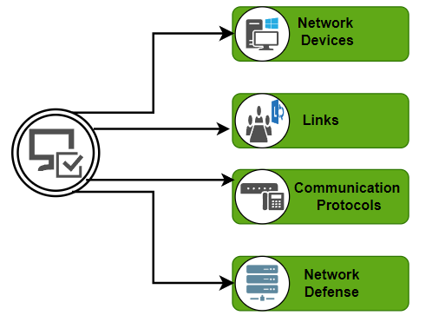
Key Components of a Computer Network
A computer network is made up of two main parts:
Devices (called nodes) &
Connections (called links)
The links connect the devices to each other.
The rules for how these connections send information are called communication protocols.
The starting and ending points of these communications are often called ports.

Slide 6
Port Numbers
In networking, ports are categorized primarily based on their port numbers, which range from 0 to 65535.
These ports are divided into three main categories as defined by the Internet Assigned Numbers Authority (IANA):
Well-Known Ports (0 – 1023)
Registered Ports (1024 – 49151)
Dynamic/Private/Ephemeral Ports (49152 – 65535)

Slide 7
Port Numbers – Well-Known Ports
Ranges from 0 – 1023
Used by: Common system or well-known services.
Reserved for: Privileged services and processes.
Examples:
20, 21 – FTP (File Transfer Protocol)
22 – SSH (Secure Shell)
23 – Telnet
25 – SMTP (Simple Mail Transfer Protocol)
53 – DNS (Domain Name System)
80 – HTTP (HyperText Transfer Protocol)
443 – HTTPS (HTTP Secure)

Slide 8
Port Numbers – Registered Ports
Ranges from 1024 – 49151
Used by: User processes or applications.
Registered with IANA for specific services by software developers.
Examples:
1433 – Microsoft SQL Server
3306 – MySQL Database
3389 – Microsoft RDP (Remote Desktop Protocol)
8080 – HTTP alternative port (often used by web servers)

Slide 9
Port Numbers – Dynamic/Private/Ephemeral Ports
Ranges from 49152 – 65535
Used by: Temporary connections, usually client-side.
Assigned dynamically by the operating system when an application requests a network connection.
Examples:
Any port in this range used for NAT (Network Address Translation), temporary communication, or client-side connections in TCP/UDP communications.

Slide 10
Networking devices
Networking devices are hardware components used to connect computers, printers, phones, cameras, servers, and other devices to a network, enabling them to communicate and share data.
These devices perform functions like:
Routing data to the correct destination
Filtering or managing traffic
Connecting different types of networks

Slide 11
Common Networking Devices
Router
Switch
Hub
Modem
Access Point
Firewall
Gateway
Network Interface Card (NIC)
Repeater
Bridge

Slide 12
Router
Connects multiple networks (e.g., LAN to the Internet).
Routes data packets based on IP addresses.
Determines best path for data to reach its destination.
Often includes Wi-Fi functionality in home routers.
Offers basic security features like firewall and NAT (Network Address Translation).
Supports DHCP to assign IP addresses to devices.
Has WAN and LAN ports for external and internal network connections.
Maintains a routing table to manage data flow.
Can be configured via web interface or CLI.

Slide 13
Switch
Connects multiple devices within the same LAN.
Forwards data only to the specific device (MAC address) that needs it.
Maintains a MAC address table to map ports to devices.
Operates at Layer 2 (Data Link Layer) of the OSI model (some at Layer 3 with routing capability).
Provides faster and more efficient data transmission than a hub.
Has multiple Ethernet ports (e.g., 8, 24, 48 ports).
Used in offices, data centers, and enterprise networks to interconnect devices.
May be managed or unmanaged:
Managed: configurable, supports VLANs, monitoring, etc.
Unmanaged: plug-and-play, no configuration needed.
Reduces network collisions and improves performance over hubs.

Slide 14
Hub
Connects multiple devices in a LAN.
Broadcasts incoming data to all ports, regardless of destination.
Does not store MAC addresses or make intelligent forwarding decisions.
Operates at Layer 1 (Physical Layer) of the OSI model.
Slower and less efficient compared to switches.
Typically has multiple Ethernet ports (e.g., 4, 8, 16).
Unmanaged device – no configuration required.
Rarely used today, mostly replaced by switches.
Useful in basic setups or labs for understanding network behavior.

Slide 15
Modem
Modem = Modulator + Demodulator.
Converts digital signals from a computer to analog signals for transmission over phone/cable lines.
Connects a home or office network to the Internet via an ISP.
Typically has one port for the ISP line and one for connecting to a router or computer.
Works at the Physical Layer (Layer 1) of the OSI model.
Does not manage internal network traffic – only handles the internet connection.
Required for internet access in homes and small businesses.

Slide 16
Access Point
Provides wireless connectivity to devices within a network.
Connects to a wired network (e.g., via Ethernet) and creates a Wi-Fi network.
Acts as a bridge between wireless clients and wired LAN.
Extends Wi-Fi coverage in large areas (offices, campuses, hotels).
Operates at Layer 2 (Data Link Layer) of the OSI model.
Supports multiple devices simultaneously (smartphones, laptops, etc.).
Not the same as a router — it doesn’t route traffic between networks.
Used to improve scalability, range, and performance of wireless networks.

Slide 17
Firewall
Monitors and controls incoming and outgoing network traffic.
Acts as a barrier between trusted and untrusted networks (e.g., LAN and Internet).
Uses predefined rules to allow or block data packets.
Filters traffic based on IP address, port number, protocol, or content.
Operates primarily at Layer 3 (Network) and Layer 4 (Transport) of the OSI model.
Protects against unauthorized access, malware, and attacks.
Configurable by administrators for custom security policies.

Slide 18
Gateway
Connects two different networks that use different protocols.
Acts as a translator or protocol converter between dissimilar systems.
Enables communication between LAN and WAN, or enterprise network and internet.
Operates at all seven layers of the OSI model (depending on implementation).
Commonly used to connect internal networks to external networks (e.g., the Internet).
Can include routing, firewall, and NAT functionality.
Can be implemented as hardware, software network as an entry/exit point, or cloud-based service.
In home/office networks, the router often acts as the default gateway.

Slide 19
Network Interface Card (NIC)
Enables a device (computer, printer, server, etc.) to connect to a network.
Provides a physical interface (e.g., Ethernet port or wireless adapter).
Can be wired (Ethernet NIC) or wireless (Wi-Fi NIC).
Has a unique MAC (Media Access Control) address for identification.
Operates at Layer 2 (Data Link Layer) and interfaces with Layer 1 (Physical Layer).
Can be integrated into the motherboard or added as a separate expansion card.
Essential for network communication in desktops, laptops, and servers.
Transmits and receives data packets over the network.
Supports various speeds like 10/100/1000 Mbps or 10 Gbps and beyond.
Required for both LAN and Internet access.

Slide 20
Repeater
Amplifies and retransmits network signals to extend the range.
Used to boost weak or degraded signals in a network.
Helps maintain signal strength over long distances.
Connects two network segments using the same protocol.
Operates at Layer 1 (Physical Layer) of the OSI model.
Has no filtering or addressing capabilities — just regenerates signals.
Common in wired (Ethernet) and wireless (Wi-Fi extender) networks.
Useful when cabling exceeds the standard-length limit (e.g., 100 meters for Ethernet).
Does not reduce network traffic or collisions — just extends coverage.
Ideal for simple network expansion in homes or small offices.

Slide 21
Bridge
Connects and filters traffic between two or more LAN segments.
Forwards data based on MAC addresses.
Maintains a MAC address table to determine which segment to forward traffic to.
Helps reduce network traffic and collisions by dividing large networks.
Operates at Layer 2 (Data Link Layer) of the OSI model.
Connects networks using the same protocol (unlike a gateway).
Can segment a busy network to improve performance and efficiency.
Typically has two or more ports for connecting network segments.
Useful in legacy or small networks before switches became common.
Can be implemented as hardware or software (e.g., in virtual environments).

Slide 22
Server
A server is a computer or system that provides services, resources, or data to other computers (clients) over a network.
Servers are designed to handle multiple requests and provide consistent, centralized functionality like file storage, websites, email, databases, or applications.
Examples:
Web server,
File server,
Mail server,
Database server.

Slide 23
Client
A client is a computer or software that requests services or resources from a server.
The client initiates the communication with the server and waits for a response.
Examples:
Web browser,
email app, or
any software accessing a remote system.

Slide 24
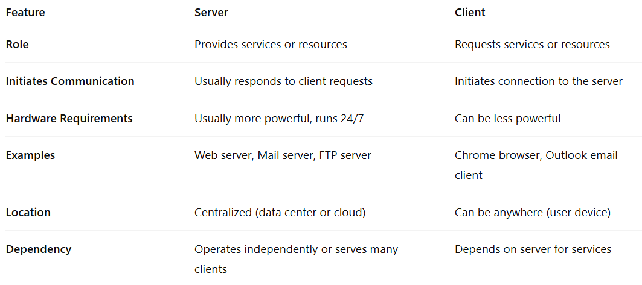
Difference Between Server and Client

Slide 25
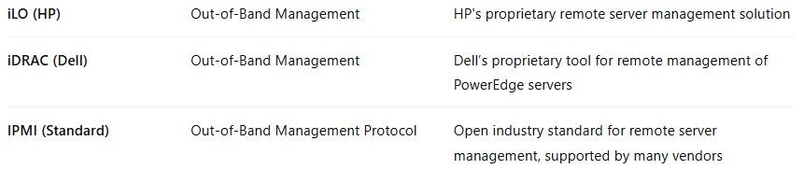
Out-of-Band Management Tools
They are part of server management hardware used for remote management and monitoring of servers independent of the operating system or server power state.

Slide 26
What Out-of-Band Management Tools Do?
Power on/off or reboot servers remotely
View hardware health (temperature, fan speed, power status)
Access the server console (even if OS is down)
Mount ISO images for remote OS installation
Manage server BIOS/firmware settings

Slide 27
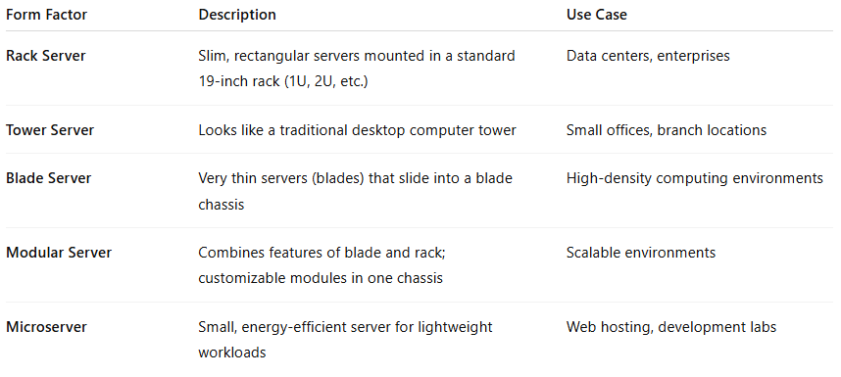
Server Form Factor
Server Form Factor refers to the physical shape, size, and design of a server system.
It defines how a server is built, how it's deployed, and where it fits—whether in a rack, on a desk, or in a blade enclosure.

Slide 28
Server events
These are system generated notifications or logs
These logs helps admins in:
Monitor
Troubleshooting
Maintenance.

Slide 29
Types of Server events:
Hardware events generated by CPU, RAM, HDD, Power supply
Power events unexpected power off, failures
Thermal events overheating warnings, temperatures
Boot/POST events events got generated at boot/POST level.
OS events OS reboots, kernel panic, service startup or failure.
Security events login attempts, breaches
Network events link up/down, IP conflict, NIC failure
Storage events disk failures
IPMI events remote access activities, sensor issues.

Slide 30
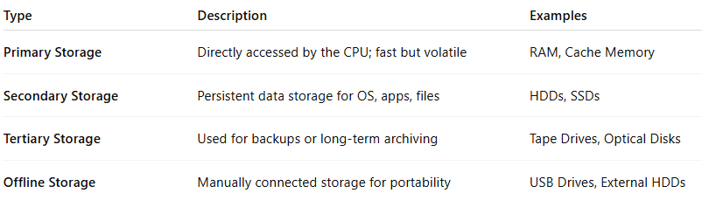
Basics of Storage
Storage in computing refers to the technology used to save, retain, and retrieve data.
It is a fundamental part of any computer system, server, or data center.
Types of Storage (by Functionality)

Slide 31
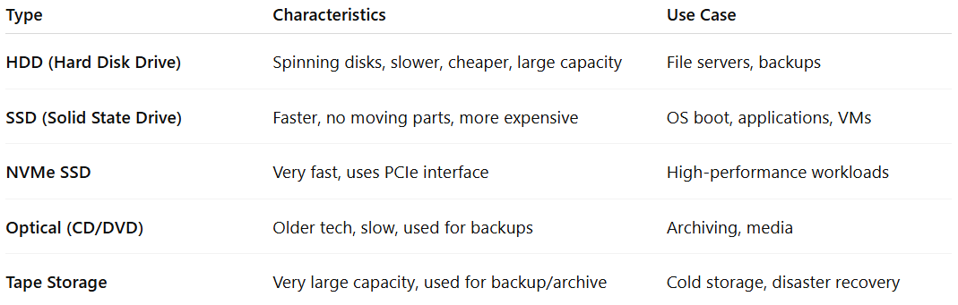
Types of Storage Devices

Slide 32
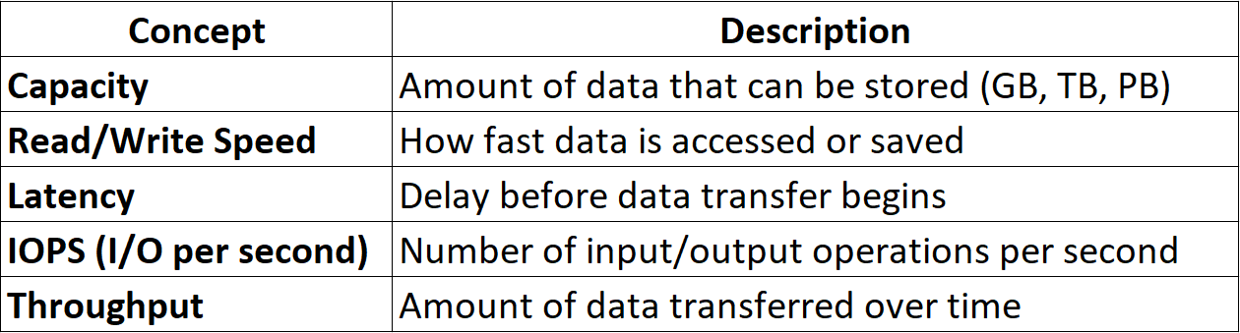
Key Storage Concepts

Slide 33
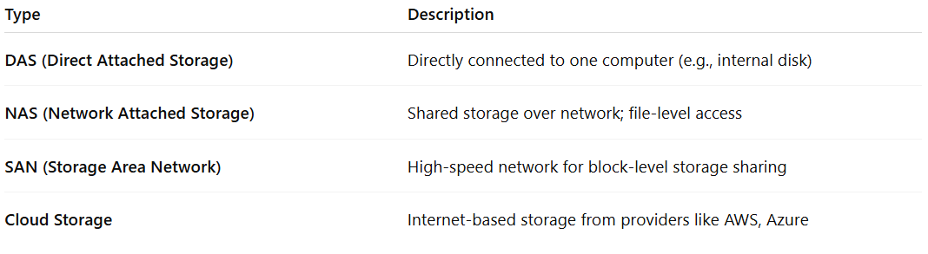
Storage Architecture Types

Slide 34
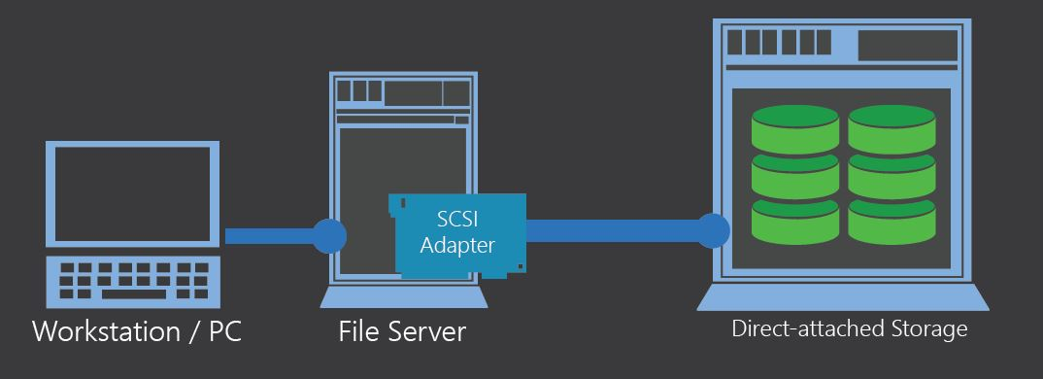
Direct Attached Storage
DAS is a storage system that is directly connected to a computer or server without using a network.
It provides a dedicated storage solution for a specific server or workstation, making it a simple and cost-effective option for data storage needs.

Slide 35
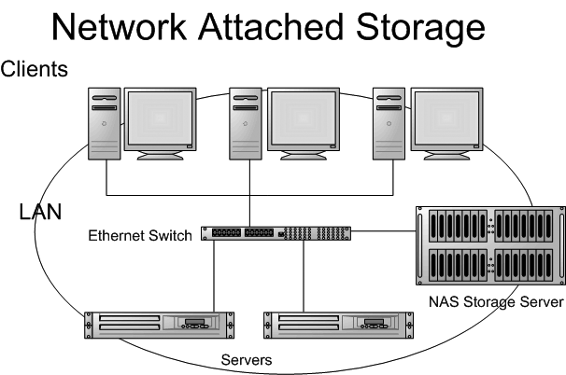
Network Attached Storage
NAS is a data storage device connected to a local network that allows multiple users or devices to access and share files stored on it.
It provides centralized, scalable storage that can be accessed remotely over a network, making it convenient for home or small office data backup and file sharing.

Slide 36
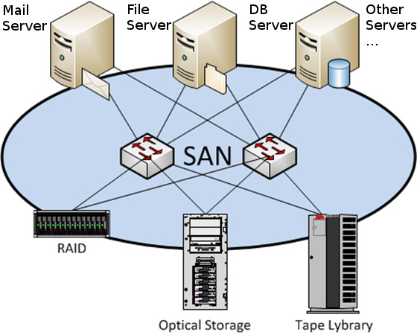
Storage Area Network
A SAN is a dedicated high-speed network that provides access to consolidated, block-level data storage.
It allows multiple servers to access shared storage devices, such as disk arrays and tape libraries, as if they were locally attached.
This enables efficient data management, backup, and disaster recovery across an organization's storage infrastructure.

Slide 37
Server Operating System
The job is to serve to the client
Server serves the request based on the need.
Ex:
DHCP server
DNS server
List of Windows servers
Windows Server NT
Windows Server 2003
Windows Server 2008
Windows Server 2008R2
Windows Server 2012
Windows Server 2012R2
Windows Server 2016
Windows Server 2019
Windows Server 2022
Windows Server 2025

Slide 38
Client Operating System
The job is to request services from server
Client has very limited permission
List of Windows Client OS:
Windows XP
Windows Vista
Windows 7
Windows 8.0
Windows 8.1
Windows 10
Windows 11

Slide 39
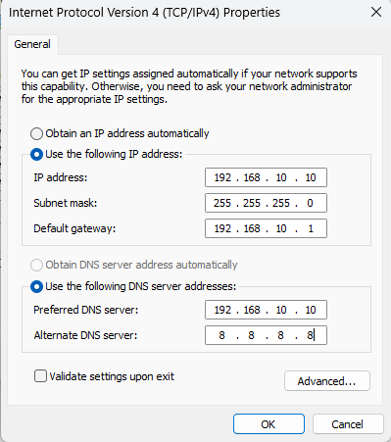
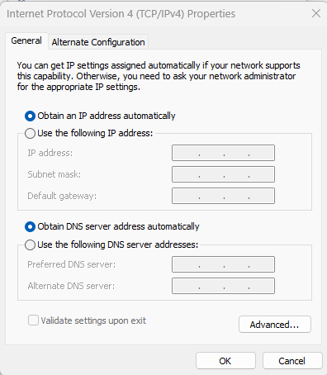
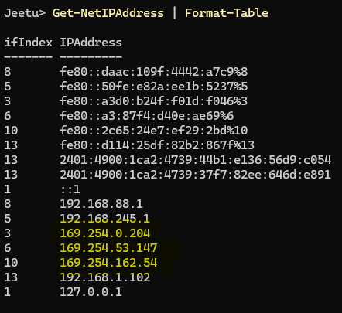
Assign IP address to server/client OS:
Static IP
Automatic IP
APIPA

Slide 40
File System
A file system controls how data is stored and retrieved.
Without a file system, information placed in a storage device would be one large block of data with no way to tell where one piece of data ends and the next begins.
Responsibilities of a File System
Organizing files and directories
Tracking location of data on disk
Managing access permissions (read/write/execute)
Ensuring data integrity and consistency
Handling metadata (file size, timestamp, owner, etc.)

Slide 41
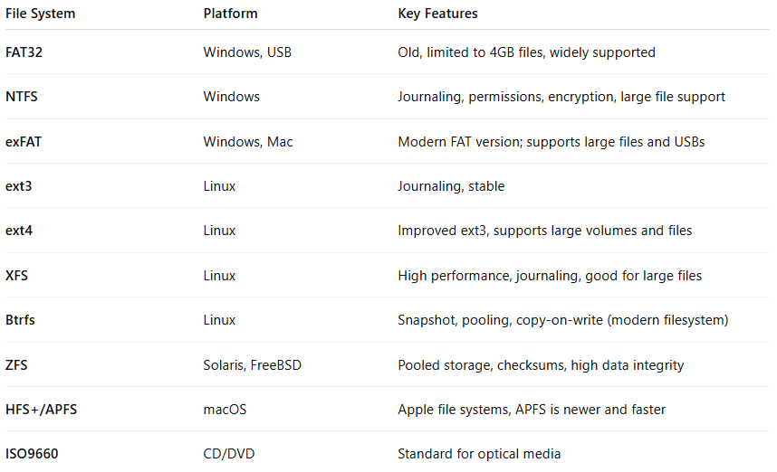
Types of File Systems

Slide 42
Storage categories
MBR
GPT
Basic disks
Dynamic disks
Storage spaces
RAID
iSCSI

Slide 43
MBR – Master Boot Record
MBR is a partitioning scheme used in storage devices (like HDDs/SSDs) to manage how data is organized and accessed.
Key Features:
Supports up to 4 primary partitions, or 3 primary + 1 extended partition.
Maximum disk size: 2 TB
Stores partition table and bootloader in the first 512 bytes of the disk.
Commonly used in older systems and BIOS-based systems.
Limitations:
Doesn’t support disks larger than 2 TB.
Limited number of partitions.
Single point of failure (corruption of MBR can make disk unbootable).

Slide 44
GPT – GUID Partition Table
GPT is the modern replacement for MBR, used in UEFI-based systems.
Key Features:
Supports 128 partitions by default (Windows).
Maximum disk size: over 9 ZB (Zettabytes).
Stores multiple copies of partition table for redundancy.
Each partition has a Globally Unique Identifier (GUID).
Advantages:
Can handle disks larger than 2 TB.
More secure and robust due to CRC checks and backup tables.

Slide 45
Basic Disks
A Basic Disk is the default disk type in Windows operating systems.
Key Features:
Uses MBR or GPT partition styles.
Can create primary partitions, extended partitions, and logical drives.
Supports standard partition operations (format, delete, mark active).
Use Case:
Best for simpler systems where you don’t need advanced volume management.

Slide 46
Dynamic Disks
A Dynamic Disk allows more advanced volume management in Windows.
Key Features:
Supports spanned, striped (RAID 0), mirrored (RAID 1), and RAID 5 volumes.
Allows volumes to span multiple physical disks.
Uses Logical Disk Manager (LDM).
Considerations:
Not compatible with all OSes (e.g., some Linux distros or older Windows).
More complex to manage and recover if disk fails.

Slide 47
Storage Spaces
Storage Spaces is a Windows feature (from Windows 8 onward) that allows combining multiple physical disks into one virtual pool.
Key Features:
Supports Simple, Mirror, and Parity layouts.
Offers resiliency, flexibility, and expandability.
Automatically duplicates data for protection (in Mirror/Parity modes).
Benefits:
Easy-to-manage software RAID.
Can expand storage without reformatting.
Works with both internal and external drives.

Slide 48
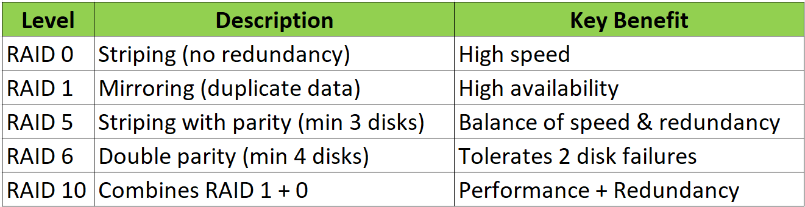
RAID (Redundant Array of Independent Disks)
RAID is a storage technology that combines multiple physical disks into one logical unit to improve performance, redundancy, or both.

Slide 49
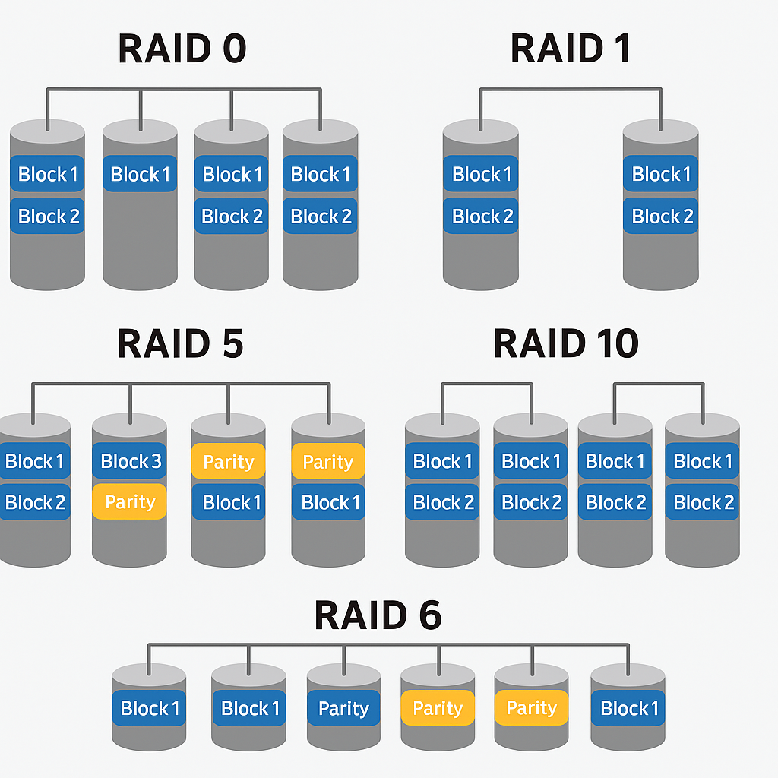
RAID 0 - Stripping
Data is divided into blocks and spread across all disks.
No data protection – if one disk fails, all data is lost.
Improves performance: both read and write speeds are faster due to parallel access.
High speed (best for large file transfers, gaming, video editing).
Maximum use of disk space (100% of total capacity usable).
No fault tolerance
Not suitable for critical data

Slide 50
RAID 1 - Mirroring
RAID 1 stores identical copies of data on two or more disks (mirroring).
Key Features:
Full redundancy: each disk contains the same data.
Requires minimum 2 disks.
If one disk fails, the system continues to run using the mirror.
High data reliability
Simple to implement
Fast read performance (can read from both disks)
Storage efficiency = 50% (half of total space is usable)
Slightly slower write speed due to duplication

Slide 51
RAID 10 – Mirrored Striping (RAID 1+0)
RAID 10 combines mirroring (RAID 1) and striping (RAID 0).
It mirrors each striped disk pair.
Key Features:
Requires at least 4 disks
Data is striped for speed and mirrored for redundancy
High performance + fault tolerance
Fast read and write speeds
Can survive multiple disk failures (if they’re not in the same mirror pair)
Only 50% of disk space usable
More costly due to redundancy

Slide 52
RAID 5 – Striping with Single Parity
RAID 5 stripes data across disks and adds parity information (used for recovery) distributed across all disks.
Key Features:
Requires minimum 3 disks
Tolerates 1 disk failure
Uses XOR parity to reconstruct lost data
Good storage efficiency (e.g., 3 disks = 66% usable)
Read performance is good
Fault tolerant
Write performance slower due to parity calculation
Rebuild time after a disk failure is long
Vulnerable during rebuild process

Slide 53
RAID 6 – Striping with Double Parity
RAID 6 is similar to RAID 5 but uses two parity blocks. It provides higher fault tolerance.
Key Features:
Requires minimum 4 disks
Can tolerate 2 disk failures simultaneously
Distributes 2 parity blocks across the array
High fault tolerance
Good read performance
Safer than RAID 5 during rebuild
Slower writes due to double parity
More complex
Storage efficiency is lower than RAID 5

Slide 54
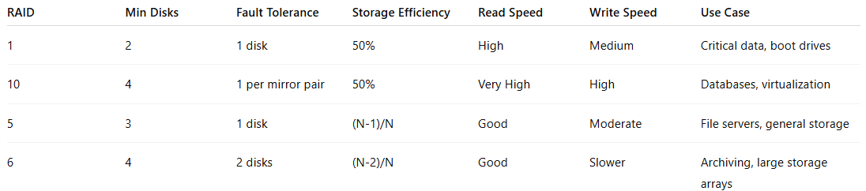
RAID Summary

Slide 55
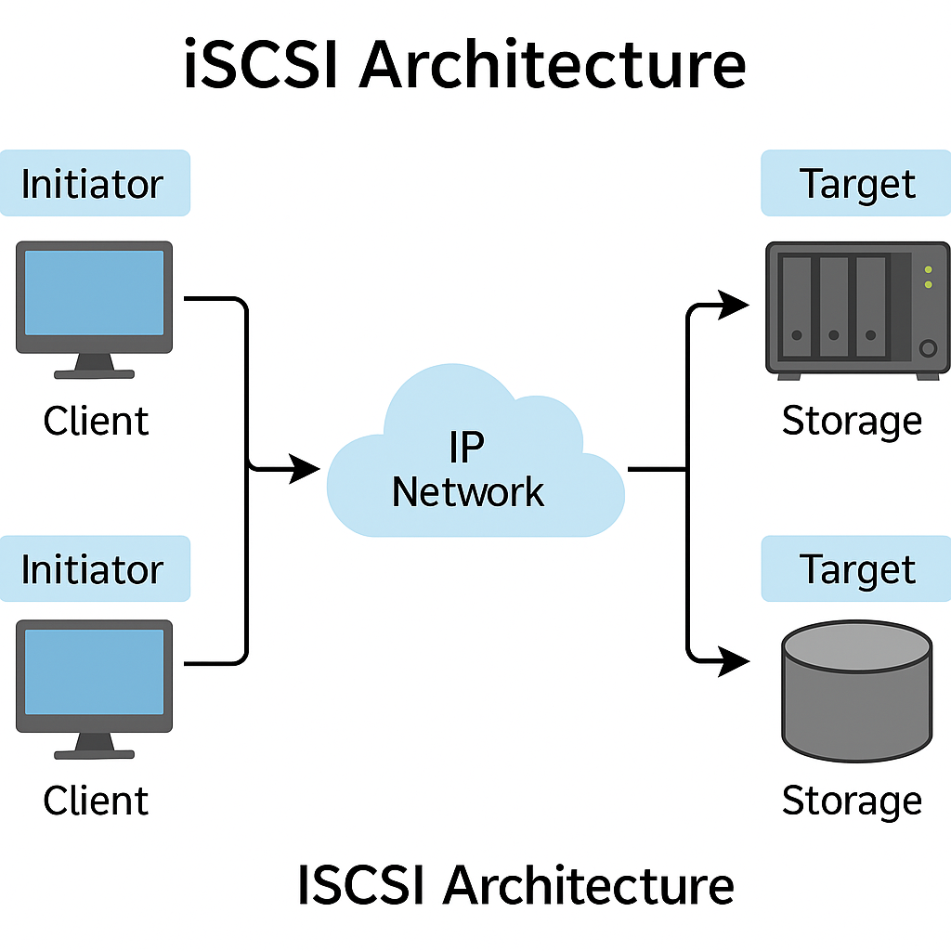
iSCSI (Internet Small Computer Systems Interface)
iSCSI is a protocol that allows block-level access to storage devices over TCP/IP networks.
How it Works:
Initiator (client): Sends I/O requests (like a disk).
Target (server): Provides access to storage blocks.
Appears to OS like a local disk, even though it's over a network.
Use Cases:
SAN (Storage Area Network) environments.
Centralized storage in virtualized and enterprise systems.
Benefits:
Low cost (uses Ethernet instead of Fibre Channel).
Scalable and flexible storage access.

Slide 56
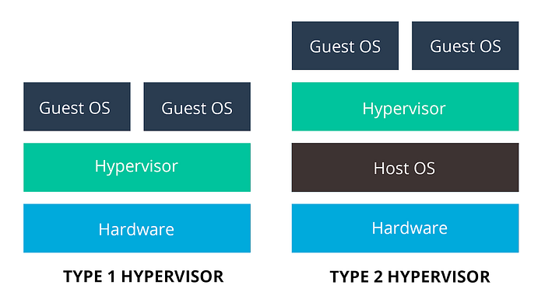
Virtualization
Virtualization can be achieved using a tool/software called "Hypervisor".
Hypervisors are of 2 types:
Type 1 Hypervisor (Bare-metal Hypervisor)
Type 2 Hypervisor (Guest-Based Hypervisor)

Slide 57
Type 1 Hypervisor
Type 1 Hypervisor (Bare-metal Hypervisor)
It does not require additional OS to function.
Type 1 is mostly used in the production environments as they provide best performance.
but they require licenses.
ex:
Microsoft Hyper-V
VMWare ESXi
Citrix XenServer
Proxmox

Slide 58
Type 2 Hypervisor
Operating system is needed. without OS, this HV will not work.
Useful for testing/home purpose.
Their performance is not equivalent to Type 1.
Ex:
Microsoft Hyper-V (Windows 10/11 - Enterprise/Pro)
VMWare workstation (free)
Oracle Virtual Box (free)
VMWare player (free)
VMWare fusion (Paid - MacOS)
Linux KVM (Kernel-based Virtual Machine) (free)

Slide 60


